Slide 1
Types of Relationship in Java

Slide 2
Type of relationship always makes to understand how to reuse the feature from one class to another class. In java programming we have three types of relationship they are.
Is-A Relationship
Has-A Relationship
Uses-A Relationship

Slide 3
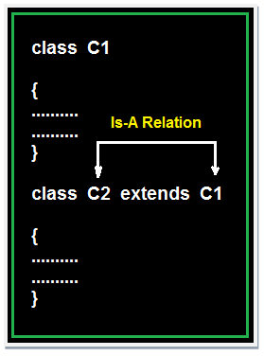
Is-A relationship
In Is-A relationship one class is obtaining the features of another class by using inheritance concept with extends keywords.
In a IS-A relationship there exists logical memory space.
# see code example “E4.java”

Slide 4
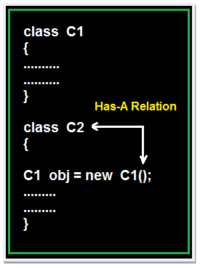
Has-A relationship
In Has-A relationship an object of one class is created as data member in another class the relationship between these two classes is Has-A.
In Has-A relationship there existed physical memory space and it is also known as part of or kind of relationship.
# see code example “E5.java”

Slide 5
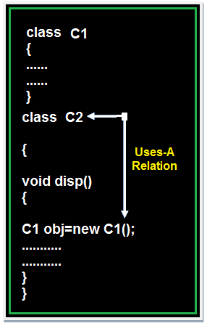
Uses-A relationship
A method of one class is using an object of another class the relationship between these two classes is known as Uses-A relationship.
As long as the method is execution the object space (o1) exists and once the method execution is completed automatically object memory space will be destroyed.
# see code example “E6.java”

